Slide 1
Composer Installation XAMPP MacOS
By Rana Zain Idrees

Slide 2
Youtube Video Link
How To Setup Laravel On MacOS XAMPP
https://www.youtube.com/watch?v=DtUY8J2T-mc

Slide 3
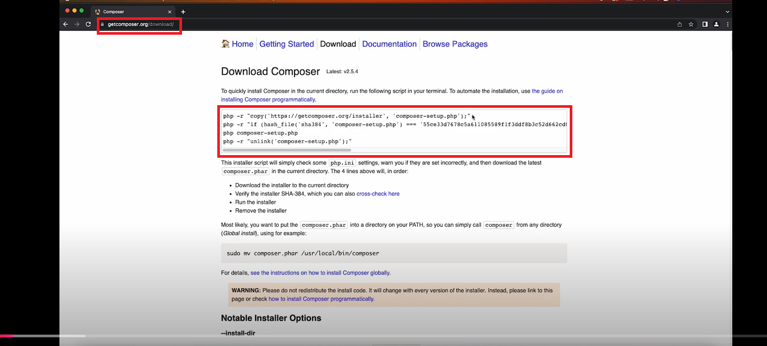
Composer Download & Installation

Slide 4
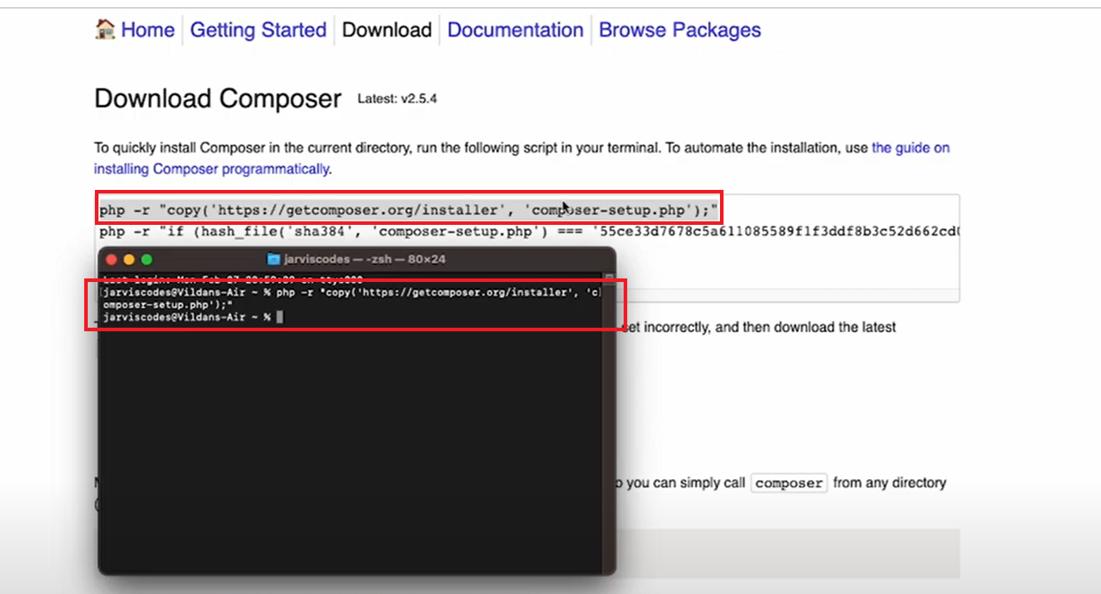
Composer Download & Installation

Slide 5
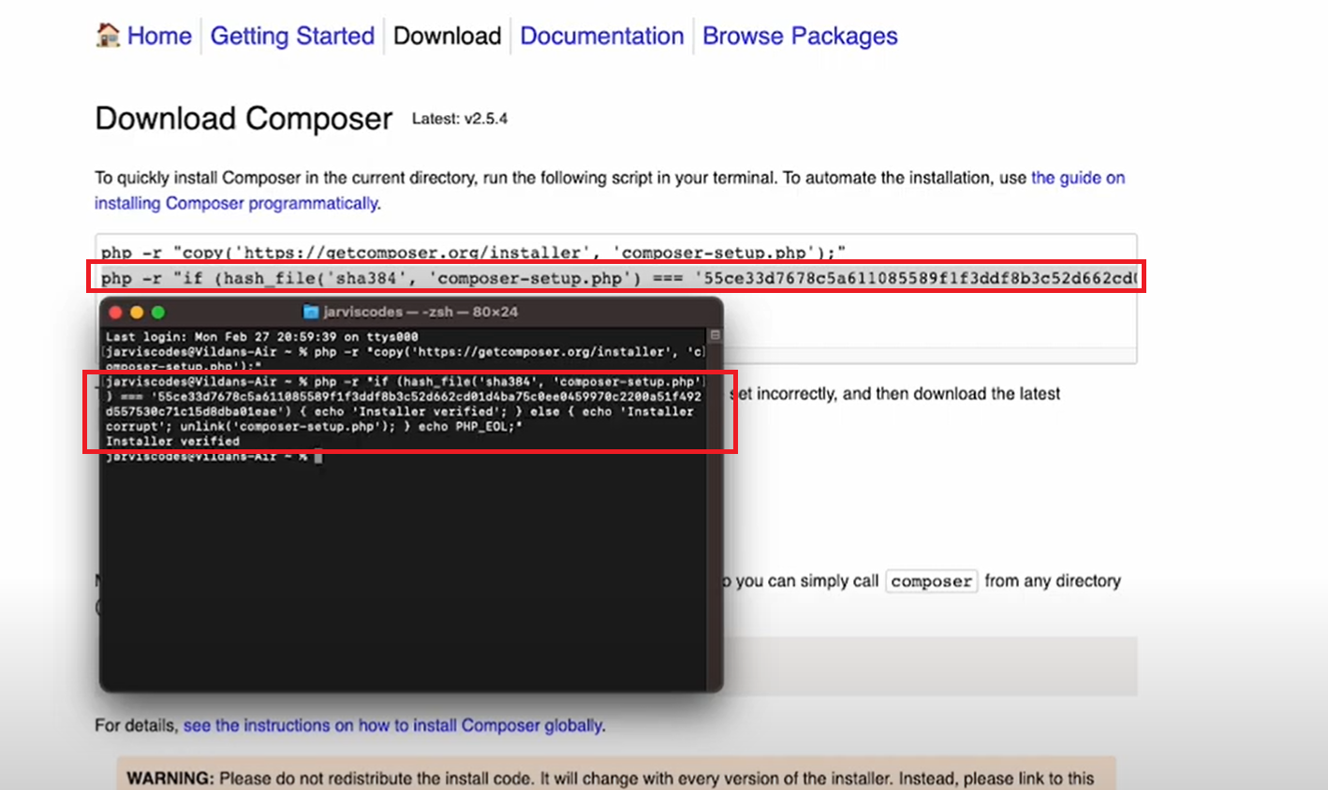
Composer Download & Installation

Slide 6
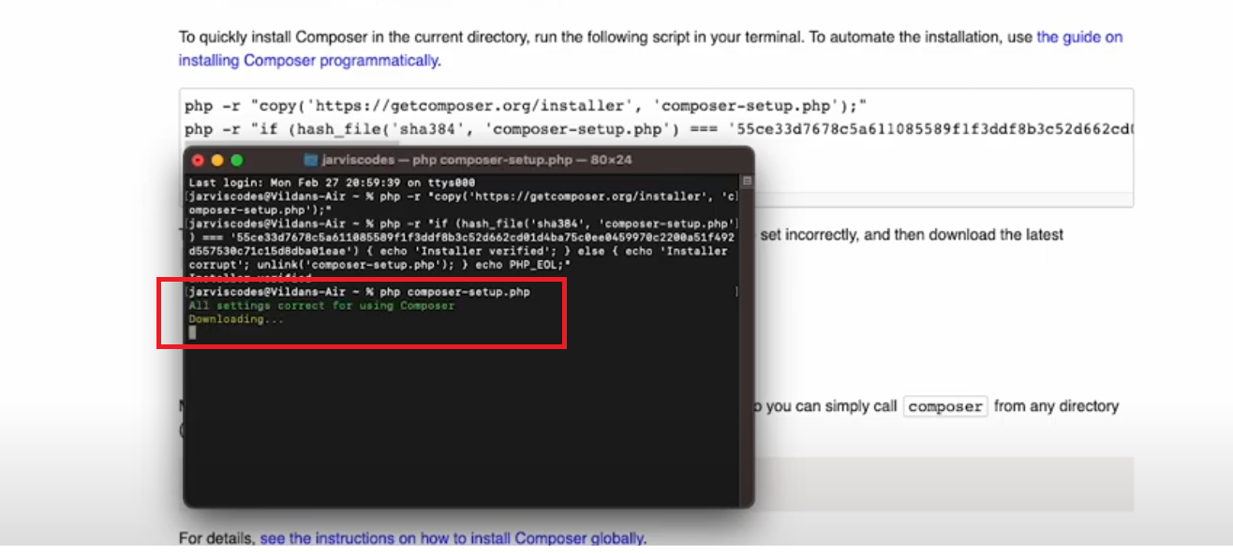
Composer Download & Installation

Slide 7
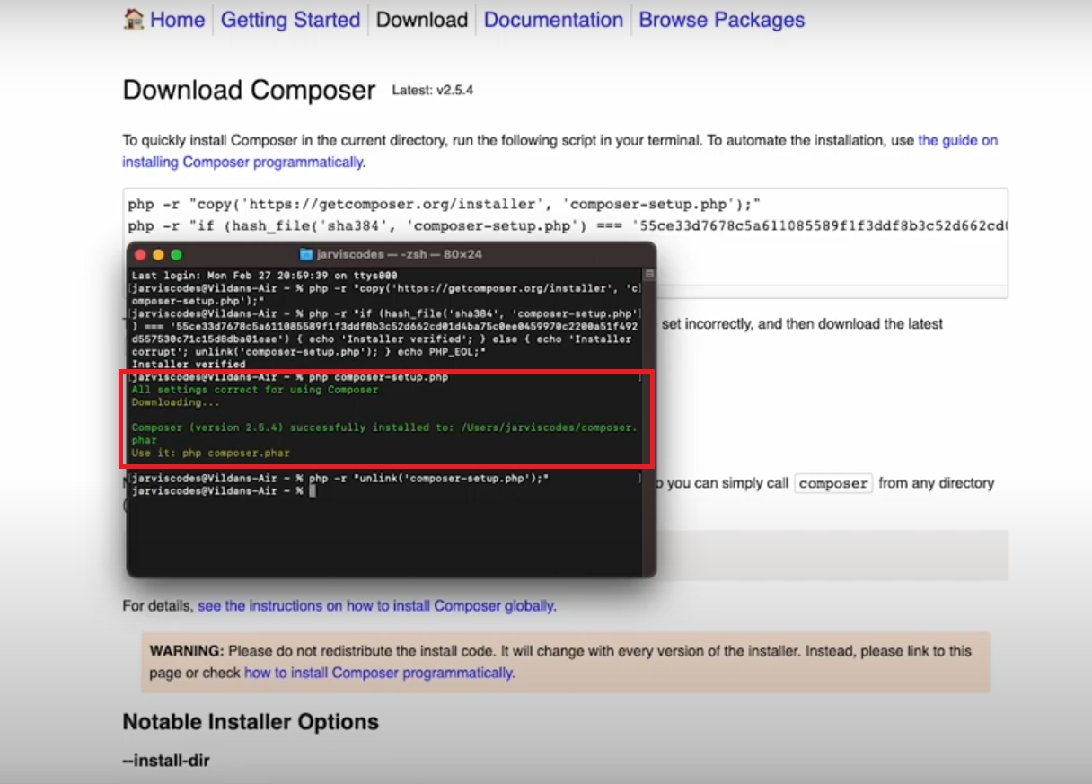
Composer Download & Installation

Slide 8
Composer Download & Installation

Slide 9
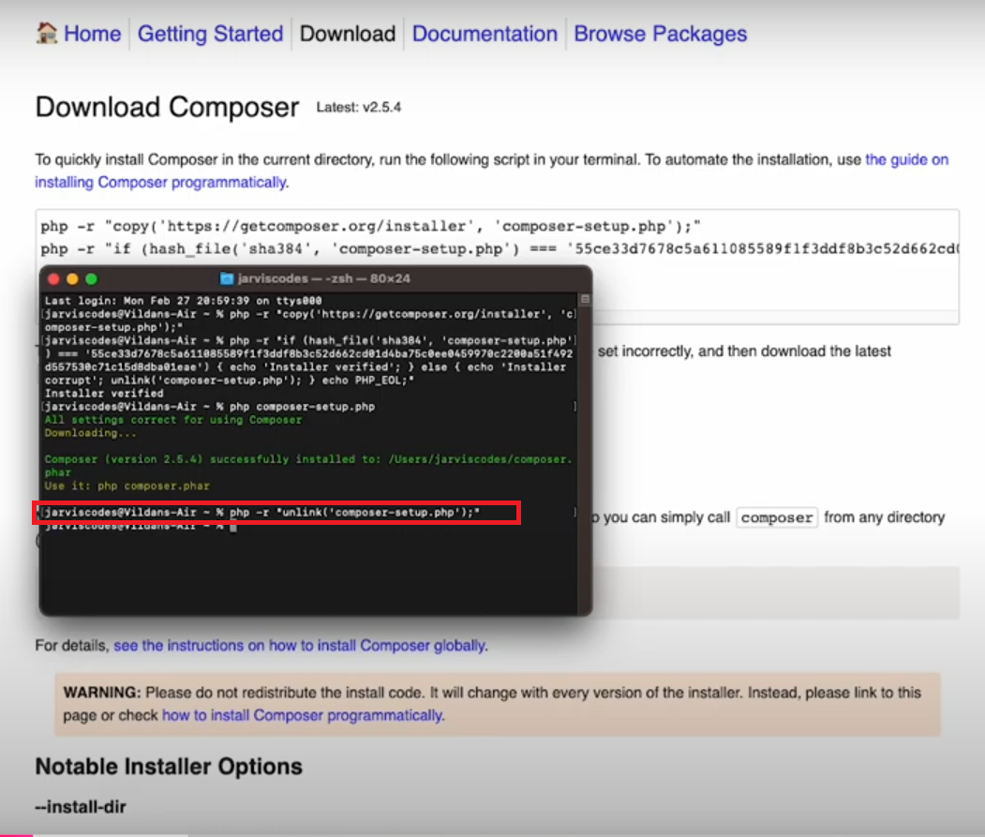
Composer Download & Installation

Slide 10
Composer Download & Installation

Slide 11
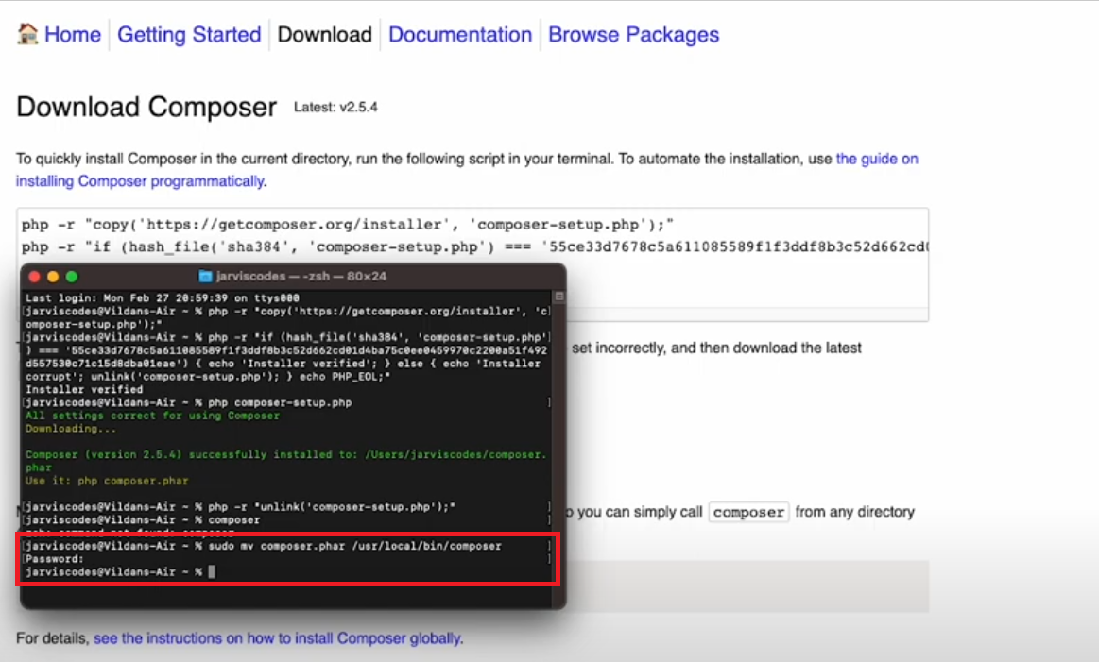
Composer Download & Installation

Slide 12
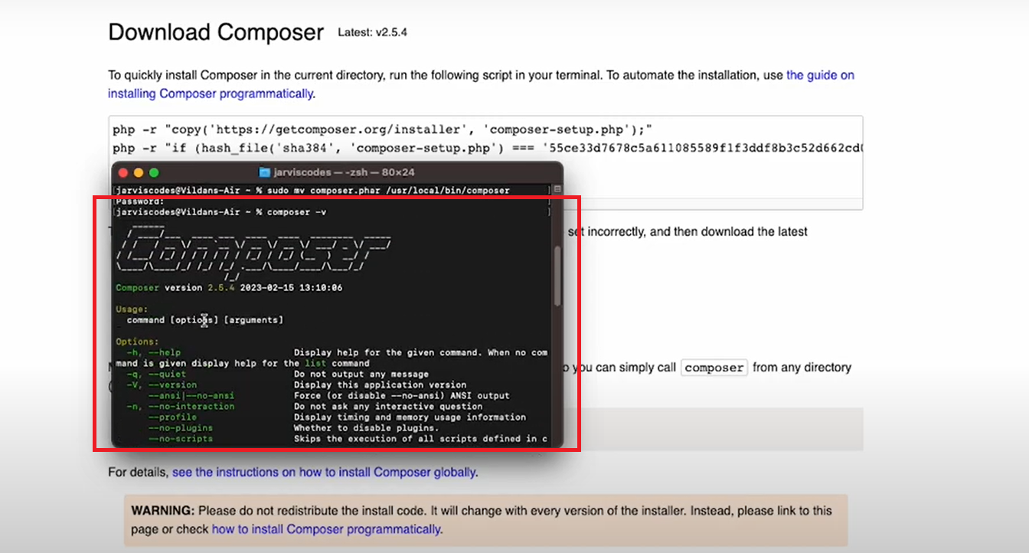
Composer Download & Installation

Slide 13
Composer Download & Installation

Slide 14
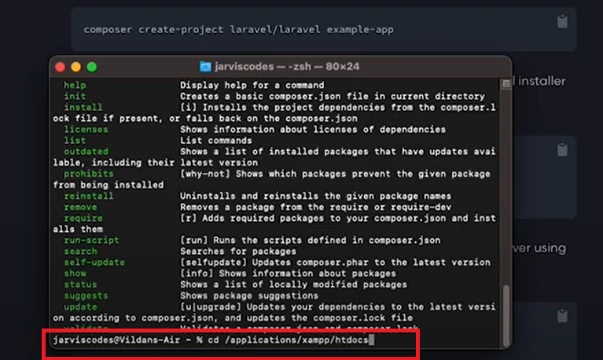
Laravel Project Creation

Slide 15
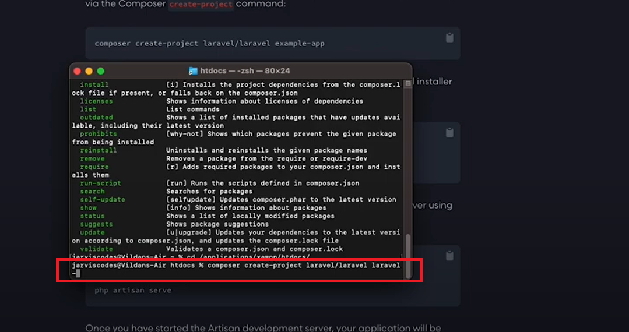
Laravel Project Creation

Slide 16
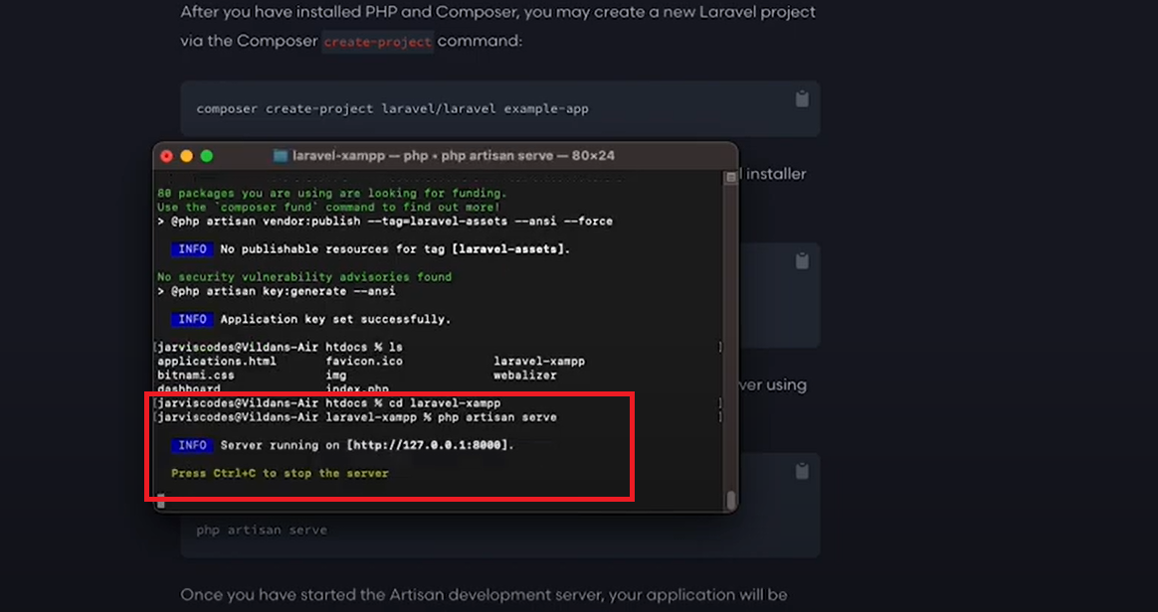
Laravel Project Setup and Serving

Slide 17
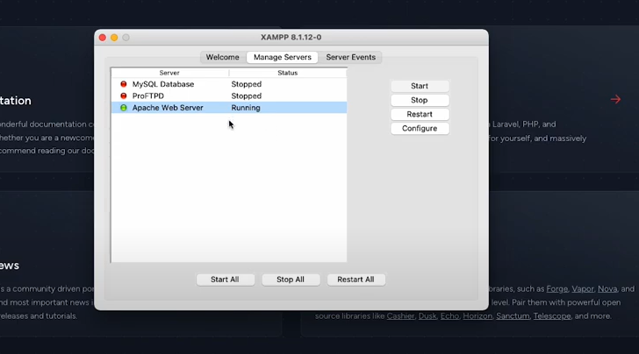
Start Apache Service

Slide 18
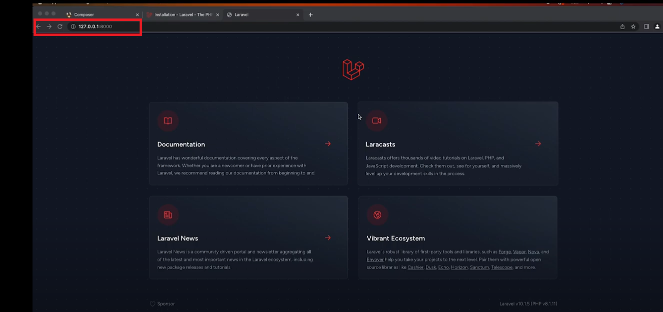
Laravel Project on 127.0.0.1:8000

Slide 19
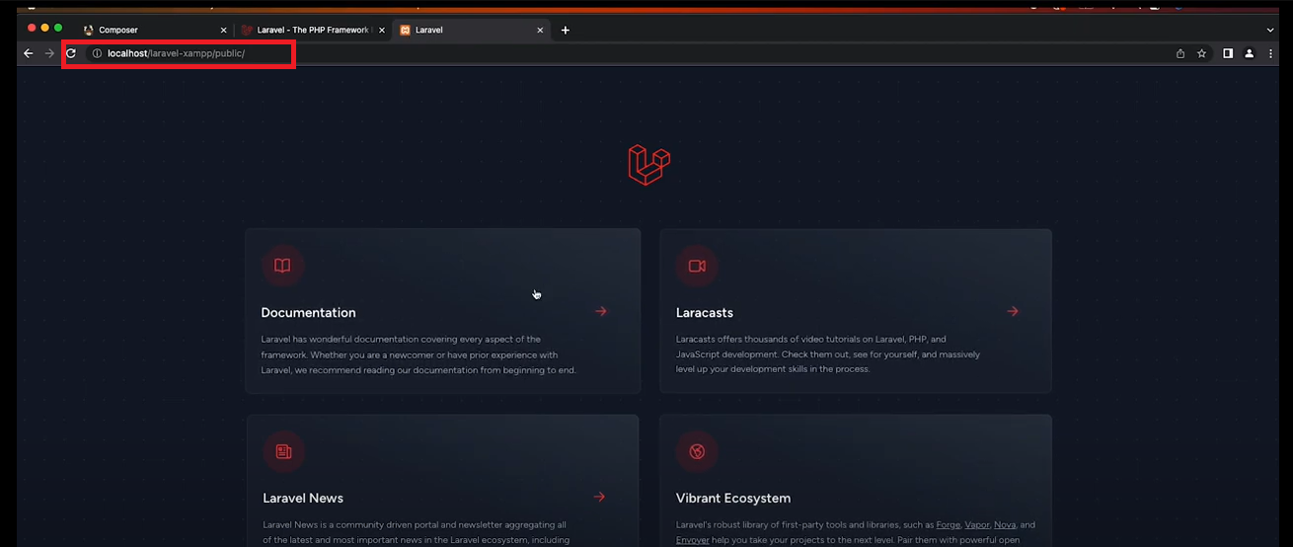
Laravel Project on Localhost

